Slide 1
Financial Loan Approval Project 4 Group 1
Larissa Fierle, Maria Villacreces, Tomas Echeverria, Milena Cuao

Slide 2
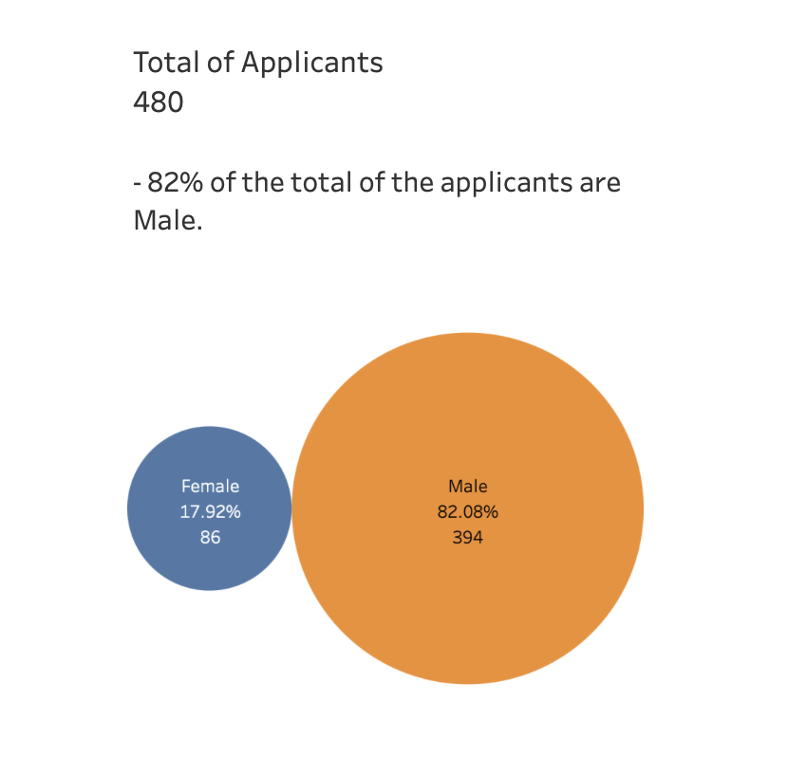
Purpose & Overview
The purpose of this project is to provide a comprehensive analysis and implementation of machine learning techniques for predicting loan approvals. By understanding the factors that influence loan approval, we can assist financial institutions in making more informed decisions, potentially reducing default rates and improving customer satisfaction.
Total Applicants: 480
Income Categories: Low, Middle, High
Objective: Analyze loan approval rates across different income categories.

Slide 3
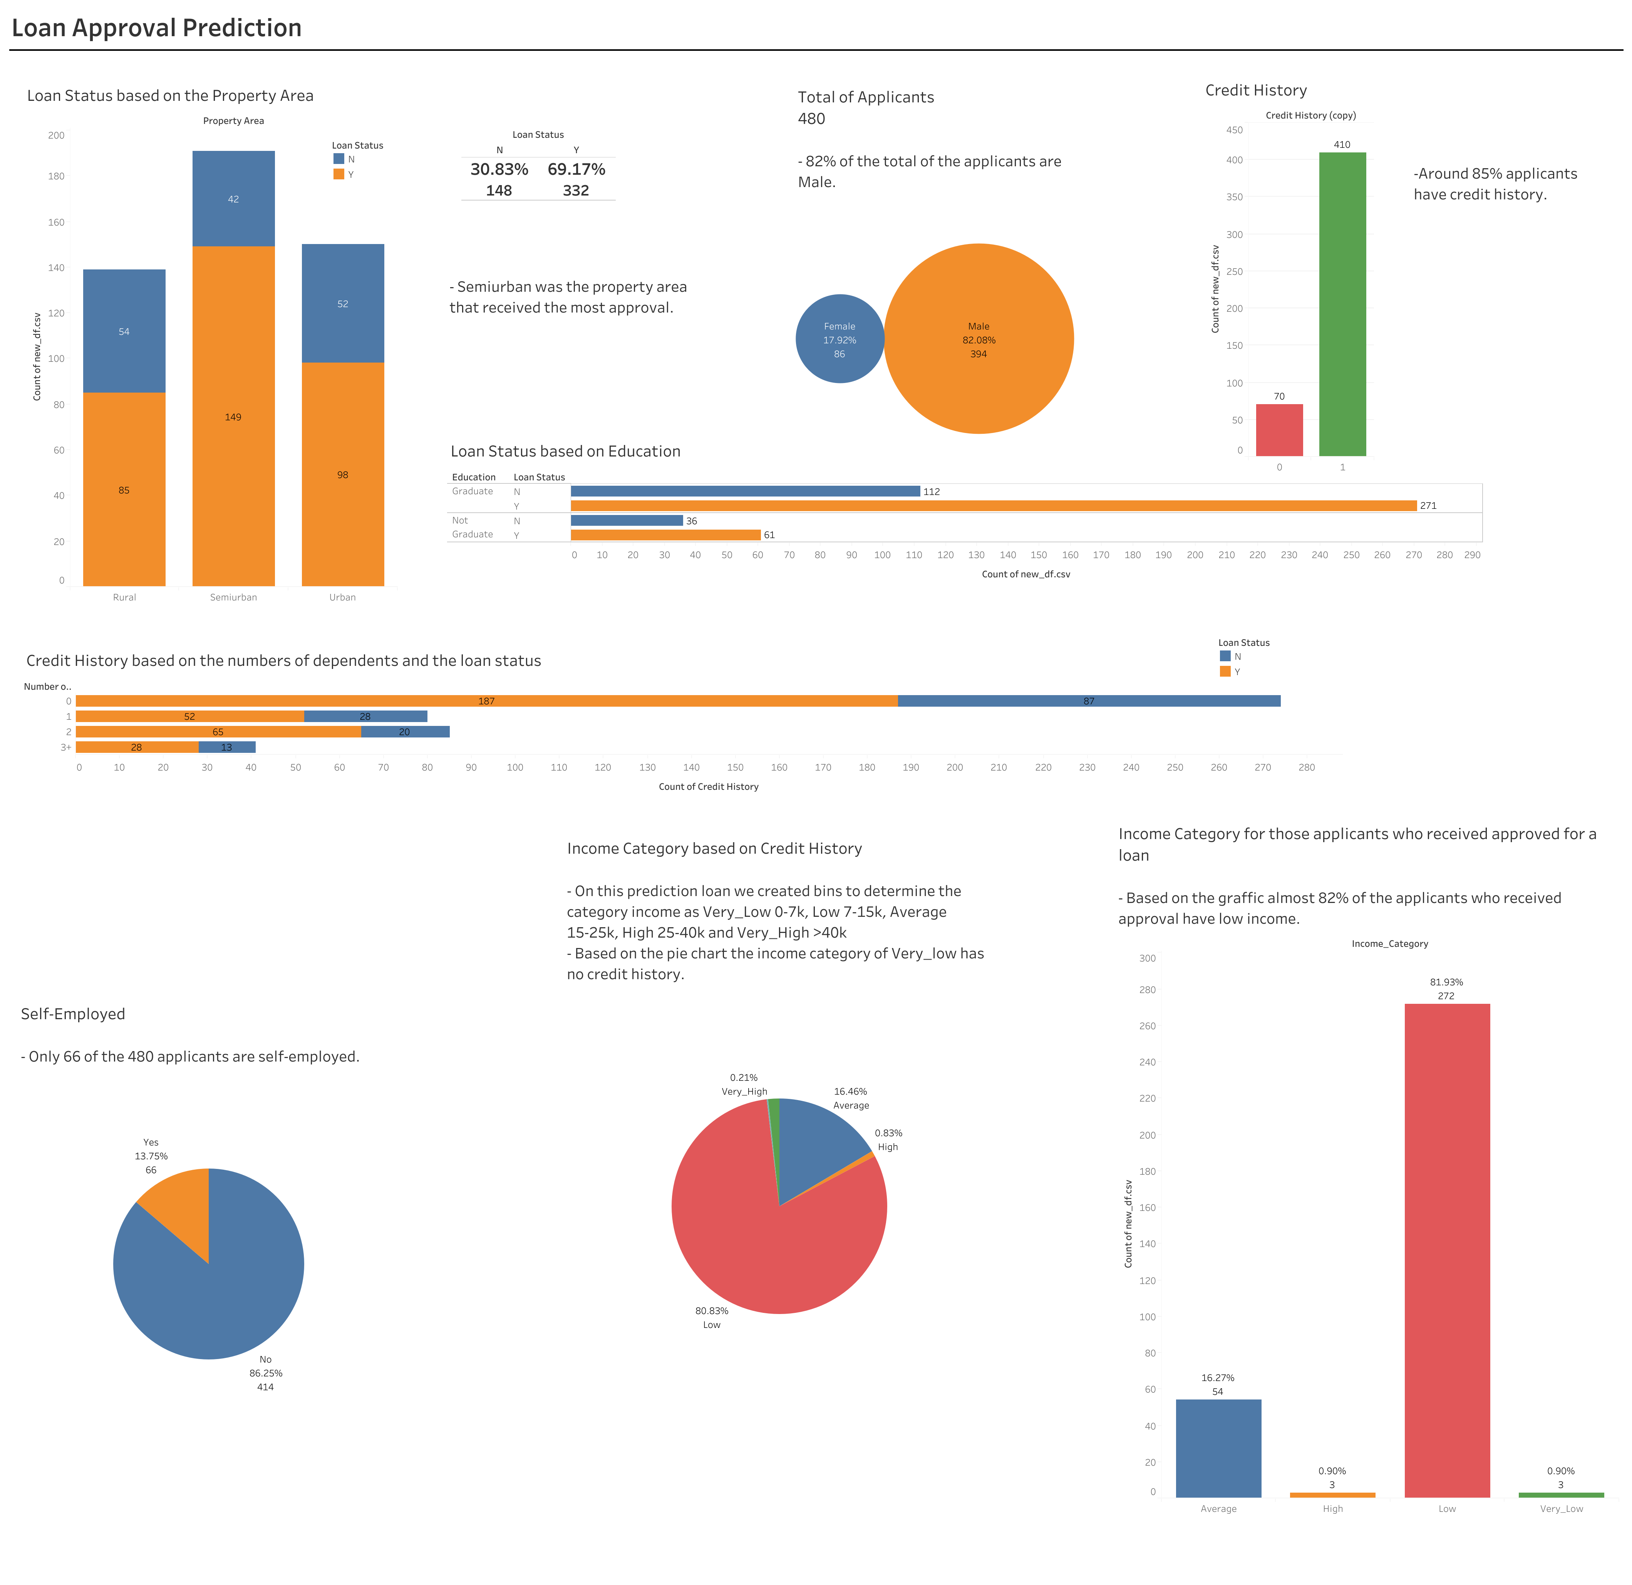
Tableau Dashboard
https://public.tableau.com/app/profile/larissa.fierle/viz/finance_loan/Applicantswhogottheloanbasedontheincomecategory?publish=yes

Slide 4
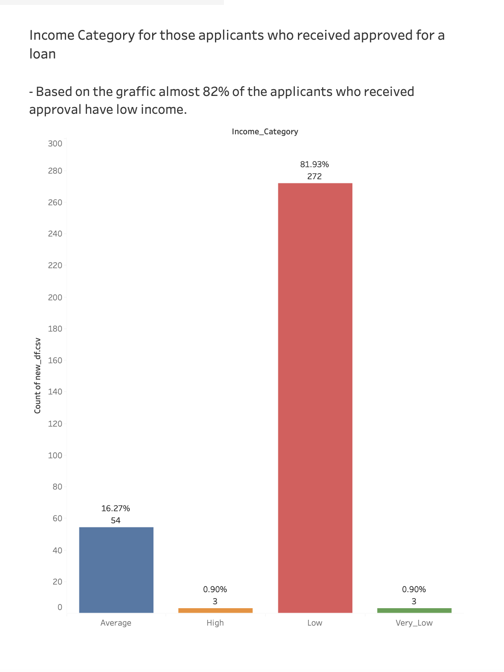
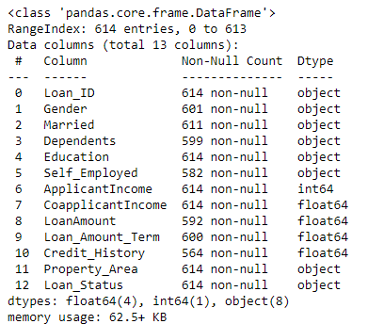
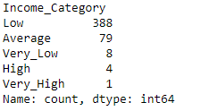
Loan Approvals by Category
Low Income:
Lower approval rates.
Higher default risk perceived.
May require additional credit checks.
Middle Income:
Balanced approval rates.
Considered stable with moderate risk.
Typical target for standard loan products.
High Income:
Higher approval rates.
Lower perceived default risk.
Often eligible for premium loan products.

Slide 5
Machine Learning Model
LOGISTIC REGRESSION
Easy to Understand: Simple and straightforward to use.
Gives Probabilities: Tells us how likely a loan is to be approved.
Good for Yes/No Questions: Perfect for deciding if a loan should be approved or not.
Shows Important Factors: Helps us see which factors matter most in loan approval.
DECISION TREE
Handles Complex Data: Works well with different types of data.
Easy to See Decisions: Shows how decisions are made in a tree format.
Works with All Data: Can use both numbers and categories.
No Rules Needed: Doesn't need strict rules about the data.

Slide 6
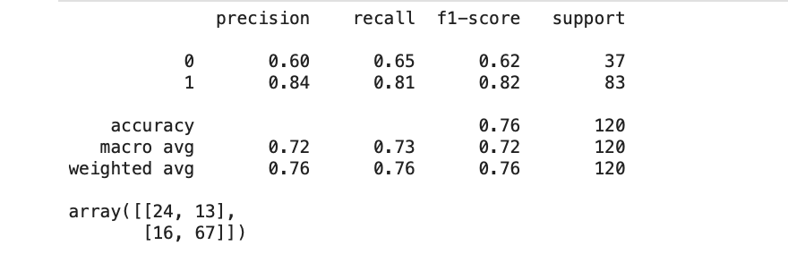
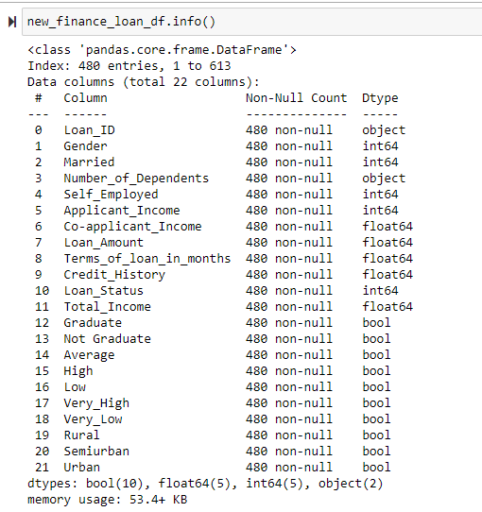
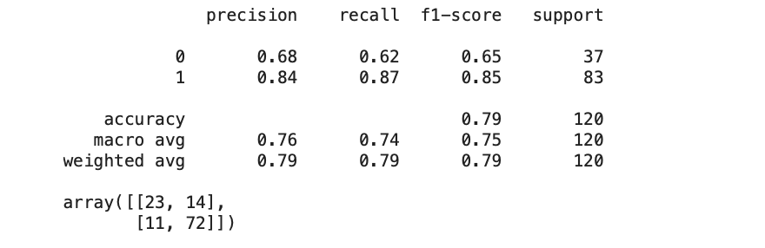
Logistic Regression
With Dummies
The performance of our model has 76% accuracy, precision of 84% and recall of 81%.
Without Dummies
The performance of our model has an improvement after dropping the dummies columns 79% accuracy, precision of 84% and recall of 87%.

Slide 7
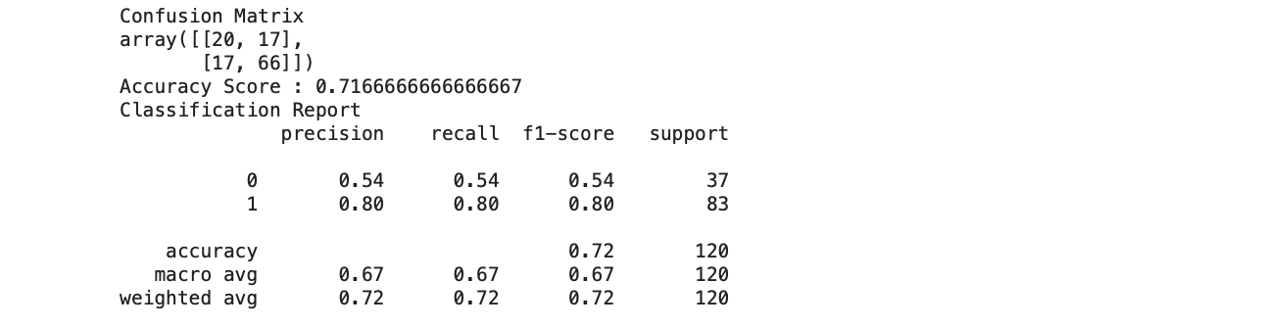
Decision Tree

